Slide 1
Problem Statement: Revolutionizing Loyalty with Blockchain
Team Name: 686157-UY93N6R4

Slide 2

Team members details
Team Name | 686157-UY93N6R4
Institute Name/Names | Indian Institute of Technology (Indian School of Mines), Dhanbad
Team Members > | 1(leader) | 2 | 3
Name | Avinesh Singh | Avinash Kumar | Rashi Kumari
Batch | 2024 | 2024 | 2024

Slide 3
Introduction
Blockchain-based Loyalty and Rewards Program
using Fungible Tokens.
Purpose: Our project aims to revolutionize E-commerce loyalty programs by leveraging blockchain technology.
Key Objectives: Enhancing security, transparency, and user engagement are our primary goals.
Existing Challenges: Traditional loyalty programs often suffer from opacity and slow settlements.
Our Solution: We're offering a new paradigm with transparency, efficiency, and accountability through blockchain-based transactions.
Transformational Potential: This project has the potential to reshape how E-commerce platforms engage with their customers.

Slide 4
Glossary
Blockchain: A decentralized and distributed digital ledger that records transactions across multiple computers. Each transaction is a "block" linked together in chronological order to form a "chain."
Fungible Tokens: Digital assets that are interchangeable with other tokens of the same type, allowing for seamless exchange and transfer.
Loyalty and Rewards Program: A marketing strategy that offers incentives to customers for their repeated engagement or purchases, fostering loyalty and retention.
Tokenomics: The economic model and principles governing the creation, distribution, and value of tokens within a blockchain ecosystem.
Smart Contracts: Self-executing contracts with terms directly written in code. They automate processes and execute actions when predefined conditions are met.
Transparency: The quality of being open, clear, and easily understandable, often associated with the visibility of transactions and processes on the blockchain.
Redemption: The act of exchanging loyalty points or tokens for rewards, products, or services within the loyalty program.
Polygon Blockchain: A layer 2 scaling solution for Ethereum, designed to improve scalability and reduce transaction costs.
Decaying Nature: A feature that reduces the value or availability of tokens over time to encourage timely usage or engagement.
Solidity: A programming language used for writing smart contracts on the Ethereum blockchain.
Cryptocurrency: Digital or virtual currencies that use cryptography for secure transactions and control the creation of new units.
Digital Wallet: A digital storage solution for holding cryptocurrencies, tokens, and other digital assets securely.
GUI-Based Tool: A graphical user interface that simplifies complex tasks, making them accessible to users without specialized technical knowledge.

Slide 5
Use-cases
These are the real life Applications of our project.
E-commerce Loyalty Program: E-commerce platforms can implement your blockchain-based loyalty program to reward customers for their purchases. Users earn fungible tokens for every transaction, encouraging repeat business and fostering brand loyalty.
Referral Rewards: Users who refer friends and family to the E-commerce platform can be rewarded with fungible tokens. This incentivizes word-of-mouth marketing and expands the customer base.
Social Media Engagement: By tracking users' social media interactions with the E-commerce platform (such as sharing products or leaving reviews), our program can allocate fungible tokens. This increases user engagement and promotes platform visibility.
Brand Partnerships: Brands collaborating with the E-commerce platform can issue fungible tokens to customers who purchase their products. This cross-promotion enhances brand loyalty and provides users with more diverse rewards.
Instant Settlements: The blockchain-powered settlement process ensures instant and secure transfer of fungible tokens between brands, sellers, and the E-commerce platform. This simplifies financial transactions and reduces delays.
Reward Redemption: Users can redeem their accumulated fungible tokens for discounts, exclusive products, or other rewards. Blockchain ensures the transparency of redemption and prevents unauthorized use.
Accountability and Transparency: All token transactions and reward distributions are recorded on the blockchain, providing an auditable and tamper-proof record of activities, promoting trust among all stakeholders.
Token Value Appreciation: Depending on the tokenomics defined, the value of fungible tokens could increase over time, motivating users to hold onto their tokens and engage more with the platform.
Gamification and Engagement: Your program can gamify the experience by introducing challenges, quests, or milestones. Users who complete these tasks can earn additional fungible tokens, fostering a sense of achievement.
Customer Data Security: By utilizing blockchain, you can enhance customer data security. Personal information and transaction history can be stored on-chain securely, reducing the risk of data breaches.

Slide 6
Solution statement/ Proposed approach
Our proposed approach aims to develop a robust Blockchain-based Loyalty and Rewards Program for E-commerce platforms, leveraging the power of blockchain technology to enhance security, transparency, and user engagement.
Overall Solution: Our overall solution involves the creation of a blockchain-enabled loyalty program that generates fungible tokens representing loyalty points. Users can earn these tokens through purchases. The tokens will be securely and transparently distributed to users' digital wallets, with all transactions recorded on the blockchain. Additionally, smart contracts will facilitate instant settlements and redemption of rewards, ensuring accuracy and preventing fraud. The program will provide a user-friendly interface,
support cross-platform integration, and promote data security.
Let’s Just break our problem to sub-Problems and discuss approaches for their solutions :
Token Generation and Tokenomics:
Developed a smart contract for generating fungible tokens.
Defined tokenomics including value and issuance rules.
Established governance rules for the token treasury.
Earning and Distributing Tokens: Implemented smart contracts to track user actions and distribute tokens.
Ensured secure and transparent token distribution to users.
Settlement Process and Reconciliation:
Designed smart contracts for instant and on-chain settlement between stakeholders.
Recorded settlement transactions on the blockchain for transparency.
User Interface and Tracking:
Created an intuitive interface for users to manage loyalty points and rewards.
Displayed earned points, transaction history, and available rewards.
Seller and Partner Participation:
Enabled partners to issue tokens to loyal customers through smart contracts.
Facilitated settlements between sellers, partners, and the E-commerce platform.
Redemption and Transpare
Developed smart contracts for secure and transparent reward redemption.
Prevented double-spending through blockchain validation.
Data Security and Privacy:
Utilized blockchain's inherent security for storing customer data.
Implemented encryption and privacy measures to protect user information.
Cross-Platform Integration:
Designed the loyalty program to be easily integrated with other platforms. Enabled seamless use of tokens across the ecosystem.

Slide 7
Limitations
User Experience:
The user experience can sometimes be less intuitive compared to traditional systems.
Transactions might require more steps and time due to blockchain confirmation times.
Although we tried our best to develop the transactions confirmations as optimised as possible but still there are delays and lagging because we all know that in blockchain consensus mechanisms are followed . These mechanisms require participants (miners or validators) to solve complex mathematical problems or stake significant resources before they can add a block of transactions. This process takes time and can lead to slower transaction confirmation.
But we would definitely try to came up with an optimal solution for this problem in Future !!

Slide 8
Future Scope
Let’s discuss potential enhancements, expansions, and developments that could be considered for our Blockchain-based Loyalty and Rewards Program.
Gamification Elements:
We can Incorporate gamification techniques, such as challenges, leaderboards, and levels, to make engaging with the loyalty program more entertaining and motivating.
Advanced Data Analytics:
Implement advanced data analytics to gain deeper insights into user behavior, preferences, and engagement patterns, enabling better-targeted rewards and offerings.
AI-Powered Personalization:
Use artificial intelligence to personalize reward offerings based on individual user preferences and purchase history, enhancing user experience and engagement.
Cross-Platform Ecosystem:
Extend the loyalty program to partner with other platforms beyond E-commerce, allowing users to earn and use tokens in a wider range of services.
Integration with NFTs:
Integrate Non-Fungible Tokens (NFTs) into the loyalty program to offer exclusive, collectible rewards that hold sentimental or unique value for users.
Offline Integration:
Explore ways to integrate the loyalty program with brick-and-mortar stores, allowing users to earn and redeem tokens both online and offline.

Slide 9
Let’s have a look of the overall working of our project.
I hope you would be very excited!!
Our project starts with the Home page. we can access our project in 3 profiles.
Profiles are Owner, Partner and User.
Lets discuss the functionalities of each profiles one by one.
Owner :
Can mint(create) token to any account .
Can add a partner to their E-commerce platform.
Can remove a partner (in case the partner is no longer in partnership).
Can transfer the token over the network to any account.

Slide 10
Continue…
Partner:
Can transfers token to any account
Can reward any user.
Customer:
Can do purchase (of course).
Can use the token won by purchasing to redeem any rewards.
So that was a brief intro.. Let’s actually dive into this.

Slide 11
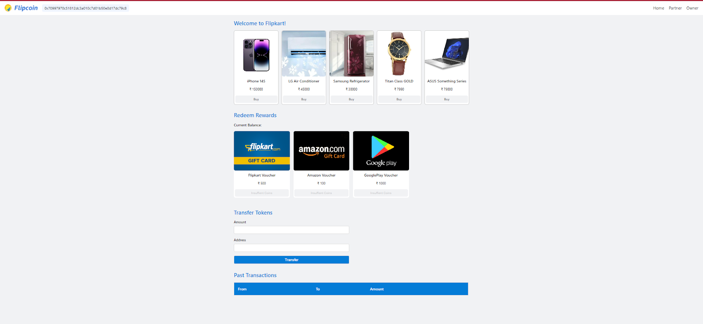
This is the Landing/Home page of current user .
You can see that in the right upper corner there are 2 profiles that is Owner and Partner.
Now the current user can purchase a product and earn coins which we named cosmos coin and use these coins for redeeming the rewards .
In the below section the current user can transfer tokens to any other user.
Also the user can keep track of past Transactions.
Home
Address of the Current user
Products
Reward for redeem

Slide 12
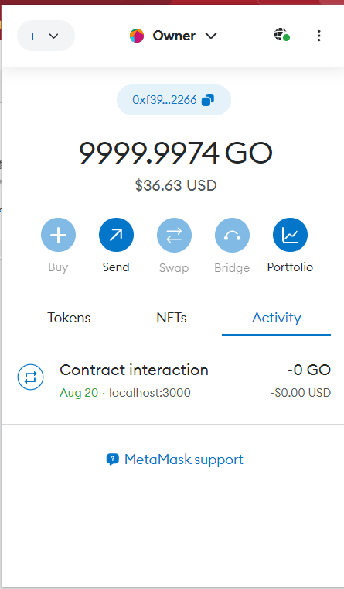
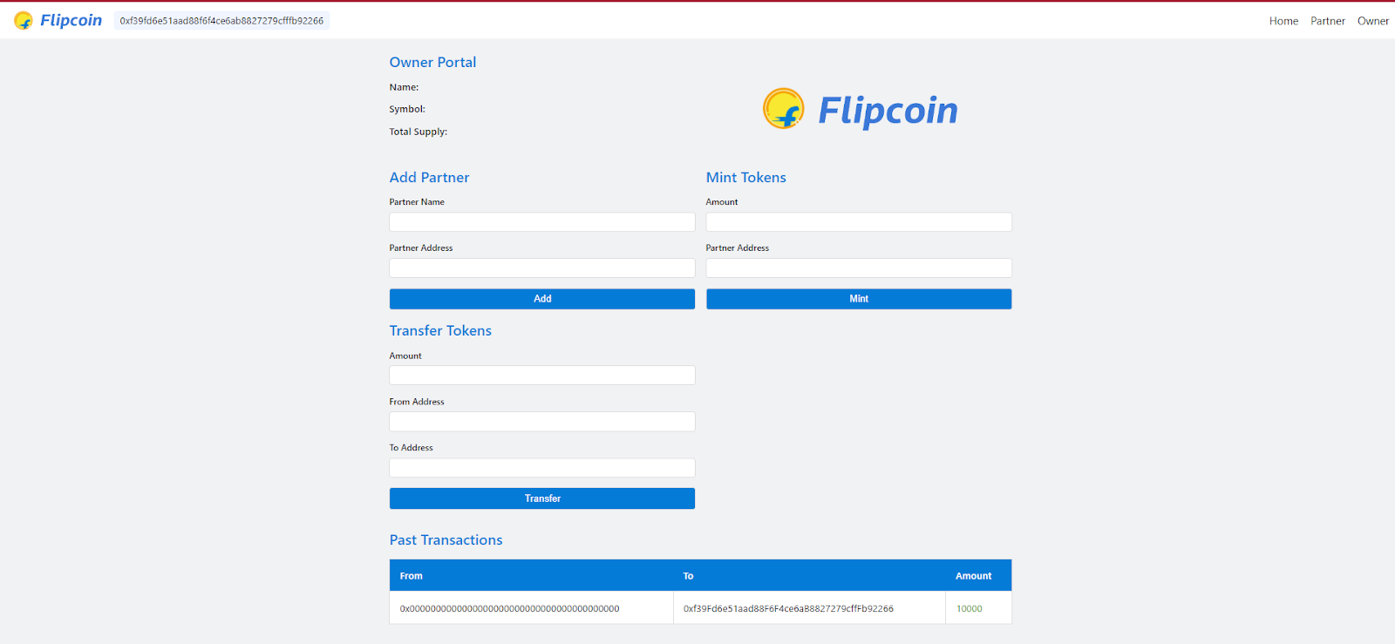
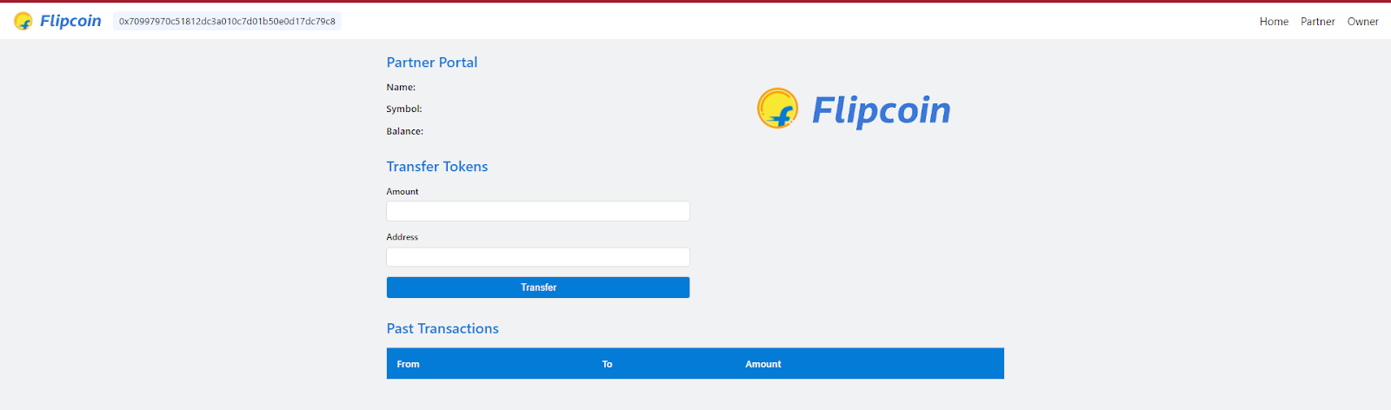
Current user
Now let’s have a brief how are we using MetaMask
We use metamask to switch over accounts and also manage our bitcoin and blockchain network.
Owner Account- Only owner will have access to this page.
Account as a Partner - Only partner will have access to this page.

Slide 13
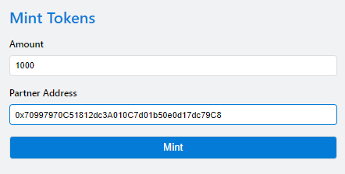
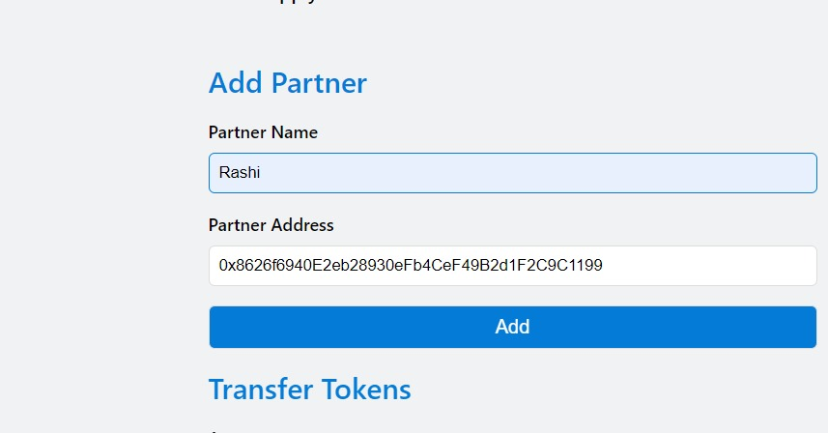
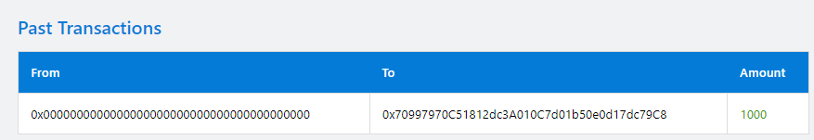
Let’s Understand the working of Owner
Minting operation by Owner
Minting 1000 Token by Owner in partner1 account
Add partner Functionality of Owner Now partner Rashi will have access to partner page
Owner can easily create tokens and transfer to Partners through their address
You can see the transaction of 1000 tokens to the partner1

Slide 14
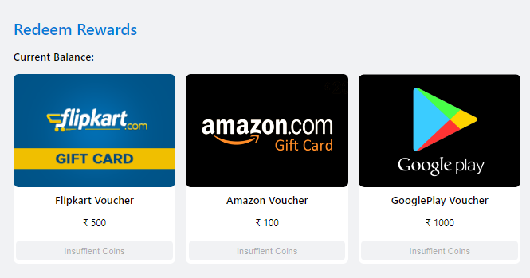
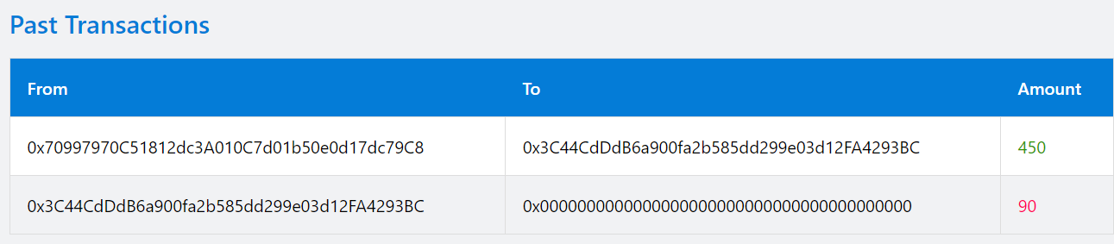
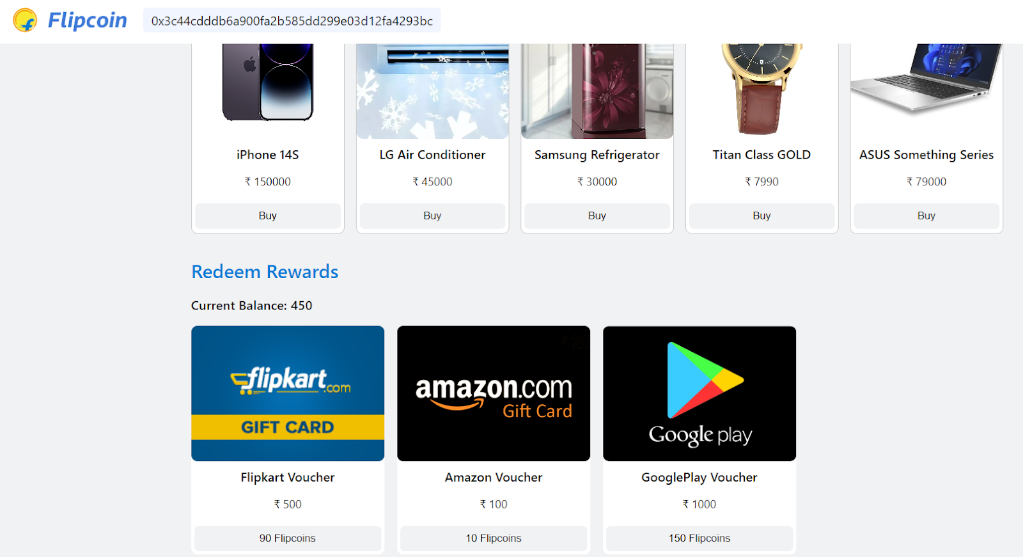
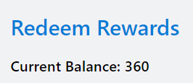
Observe Token balance of customer before purchase It is zero .
User Redeem Rewards
Customer gets 450 tokens as purchase is performed.
After Redemption 90 coin burned so finally token balance become 450-90=360

Slide 15
Thank You

